Slide 1
Analyzing Enron Emails
Team Noob Network:
Adarsh Chavakula
Gaurav Singh
Somya Singhal
Vinay Kale

Slide 2
Contents
Suspicious Network Analysis
Gender Prediction
Word Vectors Based Analysis
Suspicious Behavior
Topic Modeling
Community Clustering

Slide 3
Network Analysis
We narrowed our data down to the emails with no more than 4 recipients to target small groups of people with high exchange email rate.
We further removed emails which were sent in standard working times (9am – 8pm) and weekdays
Using this reduced data, we modelled a graph with the edge weight being the number of mails exchanged between 2 nodes (i.e. 2 persons)
When we use a threshold of 400 on the edge weight (mails exchanged) we narrow down to specific set of very interesting people

Slide 4
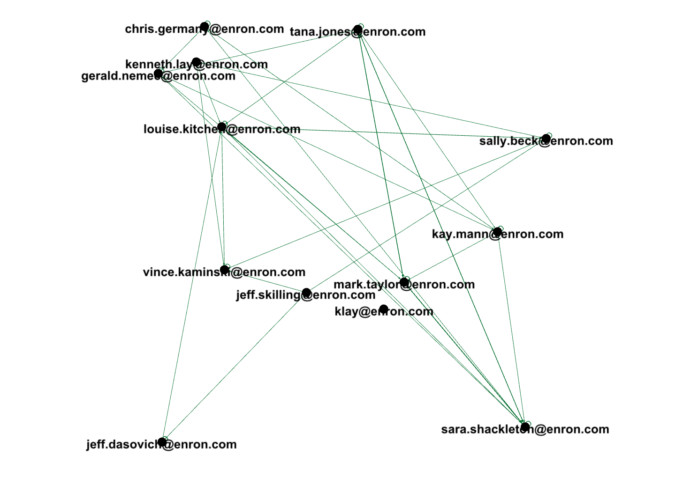
Network Analysis

Slide 5
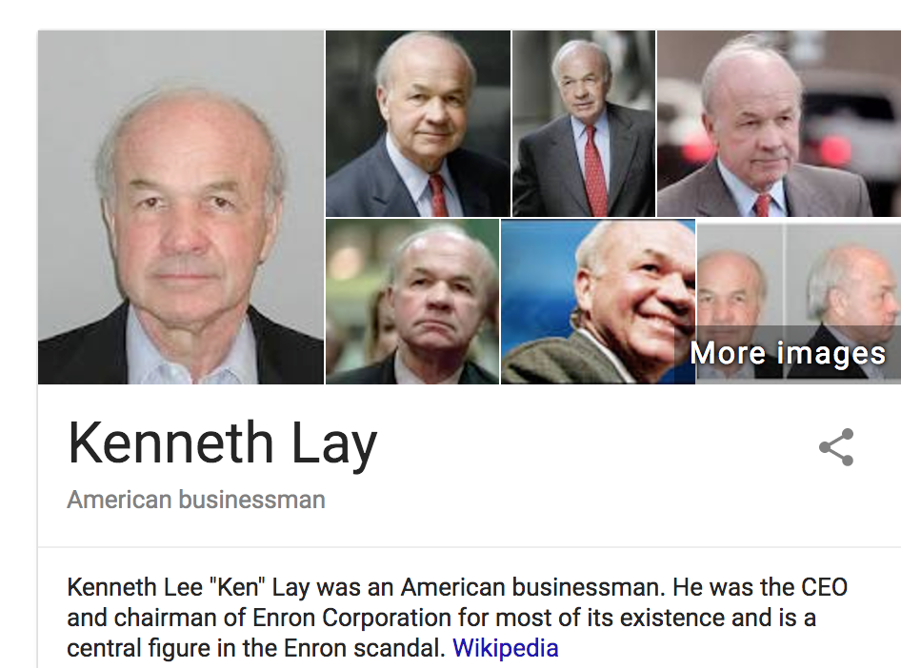
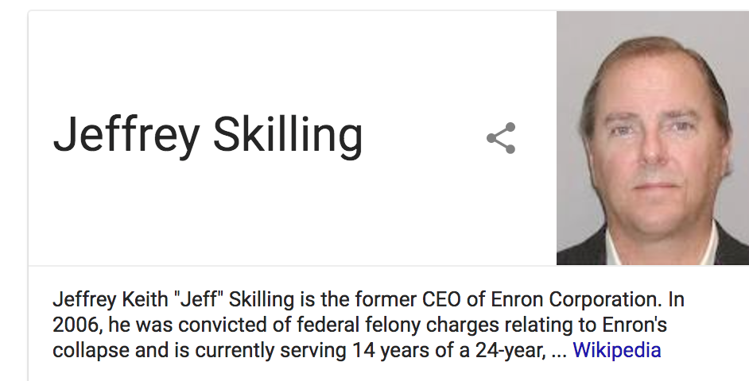
Key Perpetrators

Slide 6
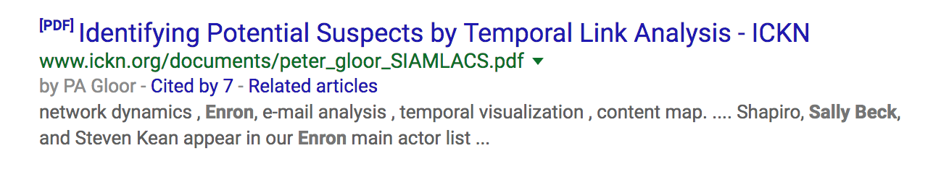
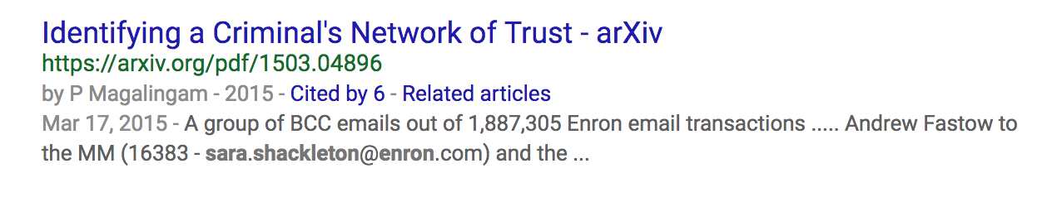
Person of Interest

Slide 7
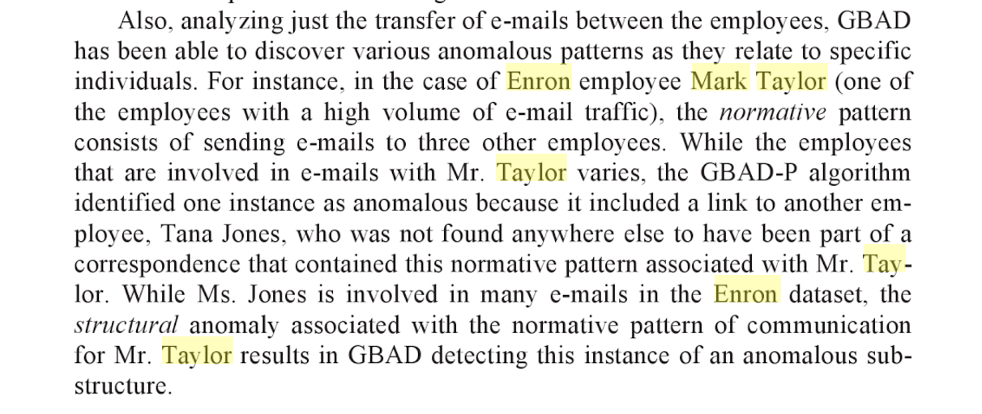

Anomalies detected
Text from book

Slide 8
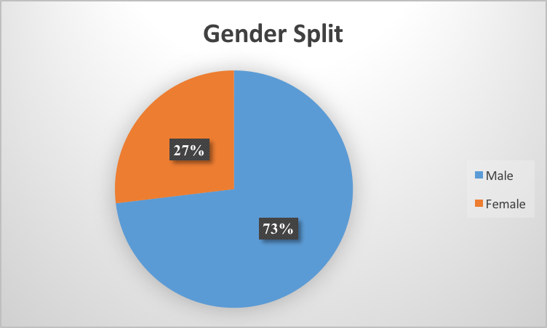
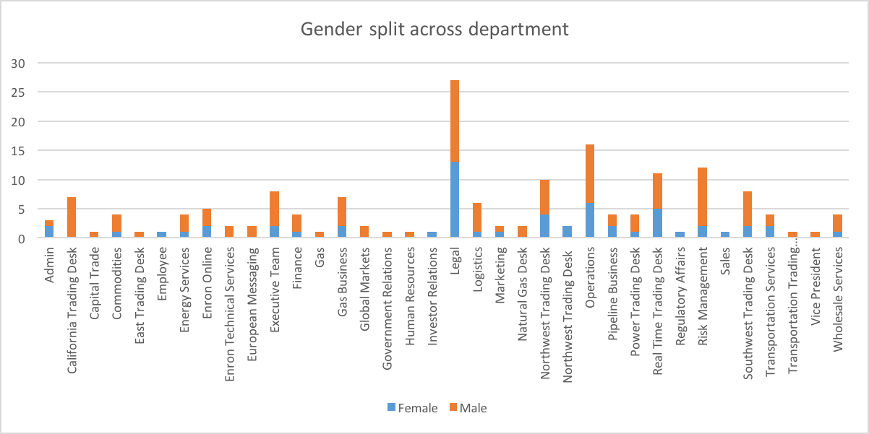
Gender Prediction
Using the Enron employee list partial data, we filtered the email addresses for names
We used a predictor which encodes gender based on names and dates of birth using historical datasets.
R package “gender”
Using the predictions, we explored the gender ratios of different departments

Slide 9
Word Vectors
Word Embeddings: represent a word with a low-dimensional vector (e.g. 300 dimensions).
The dimensions are usually latent
Often obtained using the information as in the distributional semantics approach
The Euclidean distance (or cosine similarity) between two word vectors provides an effective method for measuring the linguistic or semantic similarity of the corresponding words.
We used a pre-trained google news model to incrementally train the Enron corpus and get best results

Slide 10
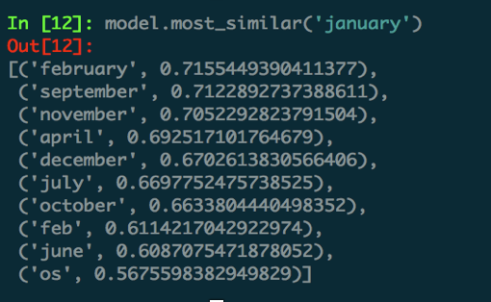
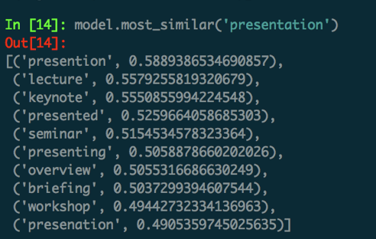
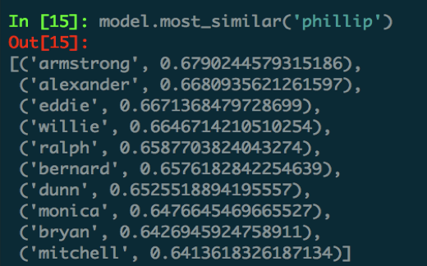
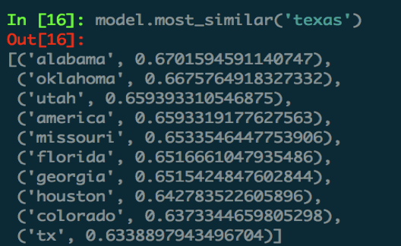
Word vectors examples : vocab size - 159,638 words, each word – 300 size vector

Slide 11
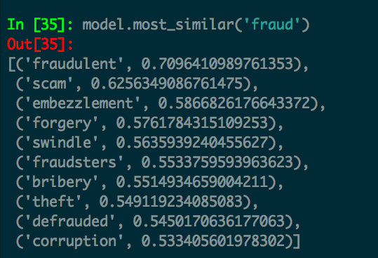
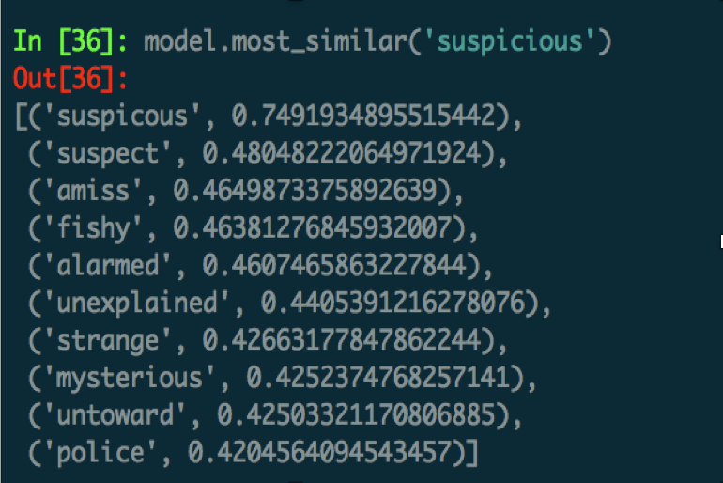
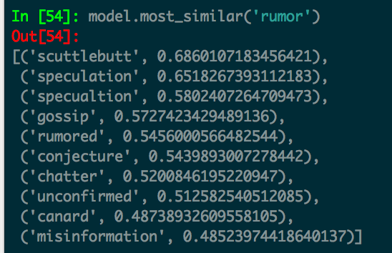
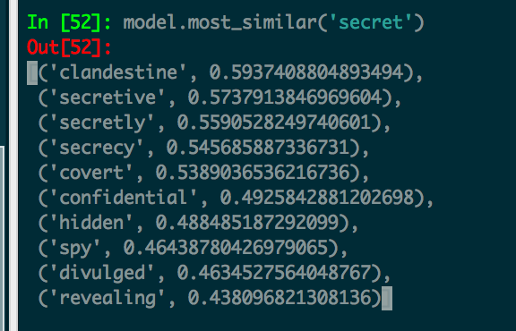
Word vectors use – Identifying suspicious / secrecy prone / rumor language

Slide 12
Word vectors use – Users with high usage of suspicious words and instances of secrecy/ rumor language
From Email-ID | Occurrences | In Graph
kay.mann@enron.com | 3926
vince.kaminski@enron.com | 1924 | Yes
sara.shackleton@enron.com | 1643 | Yes
tana.jones@enron.com | 1472 | Yes
jeff.dasovich@enron.com | 1341 | Yes
exchangeinfo@nymex.com | 1135
steven.kean@enron.com | 992
richard.sanders@enron.com | 906
enron.announcements@enron.com | 835
mark.taylor@enron.com | 656 | Yes
veronica.espinoza@enron.com | 609
chris.germany@enron.com | 597 | Yes
sally.beck@enron.com | 590 | Yes
drew.fossum@enron.com | 496
gerald.nemec@enron.com | 472 | Yes
We found the words which were relevant to Suspicious, Secret behavior with rumor language
We then found out the occurrences of these words across the email texts and ranked people by highest usage

Slide 13
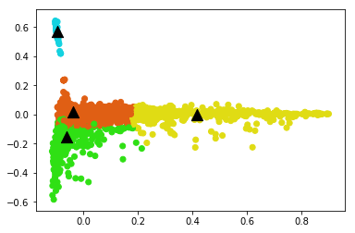
Topic Modeling
Email Etiquette
Message, Attach, Thank, Inform, Copy
Schedule related
Dinner
Call
Meeting
Week
Business Related
Enron
Corp
Fare
Renewables
Agreement
Deal
Bit Noise
Legal Related
Court
Paper
Enforcement
legal

Slide 14
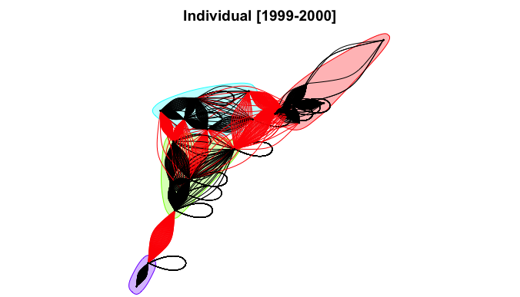
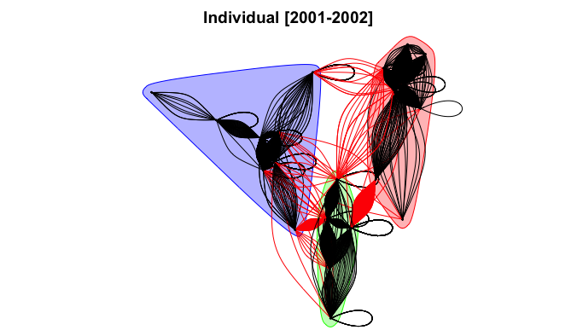
Email Network Community Collusion
Red Arrows are carriers
between communities
Colors of regions are communities
of closely connected people
Black arrows are information exchanged
within the community
Inference 1 : Fewer number of individual communities; more inter-community interactions were observed in the earlier time frame.

Slide 15
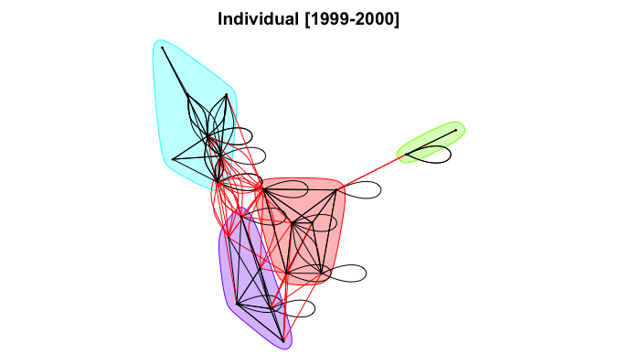
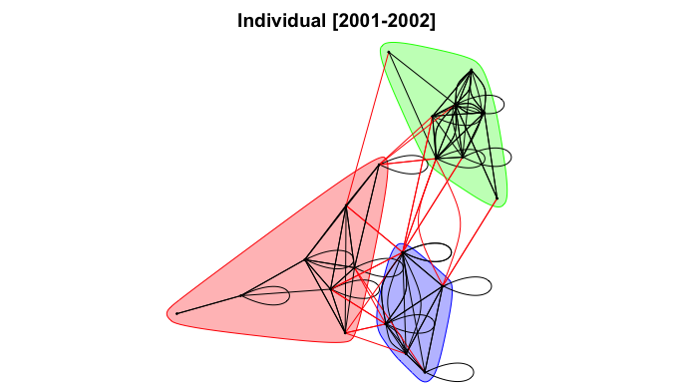
Email Connection Existence
Clearer pictures of the network
Who are the people sharing insider information between communities?
Self Arrows indicate mails sent to own
Inference 2 : Easy to observe email connectivity through interactive viz.; also email content can be reflected on the arrows.

Slide 16
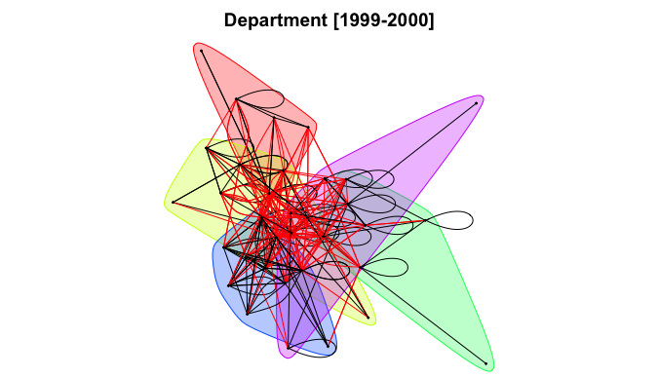
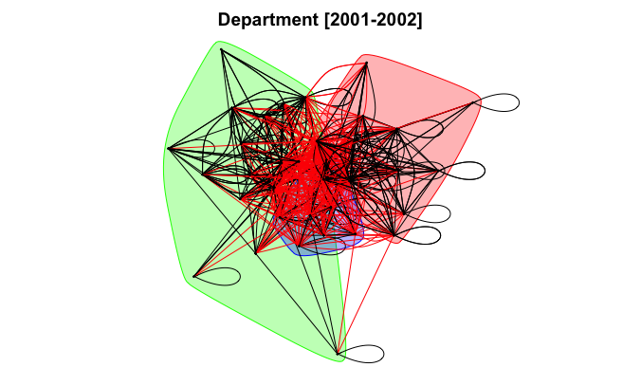
Department Collusion
Lesser number of cluster during these years as information sharing is prevalent now between departments
Colored regions indicate closely interacting departments
Inference 3 :Departments kept information in closed communities earlier with insider info carriers;
more carriers in later time with more collusion.

Slide 17
Unimplemented Ideas
Engineer/transform selected features into new features appropriate for classification modeling( on the basis of some labeled data from Network Analysis).
Test different classifiers using grid search and review performance. Investigate new data sources that may exist to provide better model performance

